Slide 1
Unit - III
Introduction to XML
Extensible Markup Language
By
Ms.J.S.Vimali

Slide 2
What is XML
XML stands for eXtensible Markup Language.
A markup language is used to provide information about a document.
Tags are added to the document to provide the extra information.
HTML tags tell a browser how to display the document.
XML tags give a reader some idea what some of the data means.
Derived from SGML(Standard Generalized Markup Language)

Slide 3
What is XML Used For?
XML documents are used to transfer data from one place to another often over the Internet.
XML subsets are designed for particular applications.
One is RSS (Rich Site Summary or Really Simple Syndication). It is used to send breaking news bulletins from one web site to another.
A number of fields have their own subsets. These include chemistry, mathematics, and books publishing.
Most of these subsets are registered with the W3Consortium and are available for anyone’s use.

Slide 4
Advantages of XML
XML is text (Unicode) based.
  Takes up less space.
  Can be transmitted efficiently.
One XML document can be displayed differently in different media.
  Html, video, CD, DVD,
  You only have to change the XML document in order to change all the rest.
XML documents can be modularized. Parts can be reused.

Slide 5
Example of an HTML Document
<html>
<head><title>Example</title></head.
<body>
<h1>This is an example of a page.</h1>
<h2>Some information goes here.</h2>
</body>
</html>

Slide 6
Example of an XML Document
<?xml version=“1.0”/>
<address>
<name>Alice Lee</name>
<email>alee@aol.com</email>
<phone>212-346-1234</phone>
<birthday>1985-03-22</birthday>
</address>

Slide 7
Difference Between HTML and XML
HTML tags have a fixed meaning and browsers know what it is.
XML tags are different for different applications, and users know what they mean.
HTML tags are used for display.
XML tags are used to describe documents and data.

Slide 8
XML Rules
Tags are enclosed in angle brackets.
Tags come in pairs with start-tags and end-tags.
Tags must be properly nested.
  <name><email>…</name></email> is not allowed.
  <name><email>…</email><name> is.
Tags that do not have end-tags must be terminated by a ‘/’.
  <br /> is an html example.

Slide 9
More XML Rules
Tags are case sensitive.
  <address> is not the same as <Address>
XML in any combination of cases is not allowed as part of a tag.
Tags may not contain ‘<‘.
Tags follow Java naming conventions, except that a single colon and other characters are allowed. They must begin with a letter and may not contain white space.
Documents must have a single root tag that begins the document.

Slide 10
Encoding
XML (like Java) uses Unicode to encode characters.
Unicode comes in many flavors. The most common one used in the West is UTF-8.
UTF-8 is a variable length code. Characters are encoded in 1 byte, 2 bytes, or 4 bytes.
The first 128 characters in Unicode are ASCII.
In UTF-8, the numbers between 128 and 255 code for some of the more common characters used in western Europe, such as ã, á, å, or ç.
Two byte codes are used for some characters not listed in the first 256 and some Asian ideographs.
Four byte codes can handle any ideographs that are left.
Those using non-western languages should investigate other versions of Unicode.

Slide 11
Well-Formed Documents
An XML document is said to be well-formed if it follows all the rules.
An XML parser is used to check that all the rules have been obeyed.
Recent browsers such as Internet Explorer 5 and Netscape 7 come with XML parsers.
Parsers are also available for free download over the Internet. One is Xerces, from the Apache open-source project.
Java 1.4 also supports an open-source parser.

Slide 12
XML Example Revisited
<?xml version=“1.0”/>
<address>
<name>Alice Lee</name>
<email>alee@aol.com</email>
<phone>212-346-1234</phone>
<birthday>1985-03-22</birthday>
</address>
Markup for the data aids understanding of its purpose.
A flat text file is not nearly so clear.
Alice Lee
alee@aol.com
212-346-1234
1985-03-22

Slide 13
Expanded Example
<?xml version = “1.0” ?>
<address>
<name>
<first>Alice</first>
<last>Lee</last>
</name>
<email>alee@aol.com</email>
<phone>123-45-6789</phone>
<birthday>
<year>1983</year>
<month>07</month>
<day>15</day>
</birthday>
</address>

Slide 14
XML Files are Trees
address
name
email
phone
birthday
first
last
year
month
day

Slide 15
XML Trees
An XML document has a single root node.
The tree is a general ordered tree.
  A parent node may have any number of children.
  Child nodes are ordered, and may have siblings.
Preorder traversals are usually used for getting information out of the tree.

Slide 16
XML Attributes
XML elements can have attributes, just like HTML.
Attributes are designed to contain data related to a specific element.
XML Attributes Must be Quoted
Attribute values must always be quoted. Either single or double quotes can be used.
For a person's gender, the <person> element can be written like this:
<person gender="female">
or like this:
<person gender='female'>
If the attribute value itself contains double quotes you can use single quotes, like in this example:
<gangster name='George "Shotgun" Ziegler'>
or you can use character entities:
<gangster name="George &quot;Shotgun&quot; Ziegler">

Slide 17
XML Elements vs. Attributes
Take a look at these examples:
    <person gender="female">
    <firstname>Anna</firstname>
    <lastname>Smith</lastname>
    </person>
    <person>
    <gender>female</gender>
    <firstname>Anna</firstname>
    <lastname>Smith</lastname>
    </person>
In the first example gender is an attribute. In the last, gender is an element. Both examples provide the same information.
There are no rules about when to use attributes or when to use elements in XML.

Slide 18
Avoid XML Attributes?
Some things to consider when using attributes are:
attributes cannot contain multiple values (elements can)
attributes cannot contain tree structures (elements can)
attributes are not easily expandable (for future changes)
Don't end up like this:
    <note day="10" month="01" year="2008"
    to="Tove" from="Jani" heading="Reminder"
    body="Don't forget me this weekend!">
    </note>

Slide 19
XML Attributes for Metadata
Sometimes ID references are assigned to elements. These IDs can be used to identify XML elements in much the same way as the id attribute in HTML. This example demonstrates this:
<messages>
<note id="501">
<to>Tove</to>
<from>Jani</from>
<heading>Reminder</heading>
<body>Don't forget me this weekend!</body>
</note>
<note id="502">
<to>Jani</to>
<from>Tove</from>
<heading>Re: Reminder</heading>
<body>I will not</body>
</note>
</messages>

Slide 20
The id attributes above are for identifying the different notes. It is not a part of the note itself.
What I'm trying to say here is that metadata (data about data) should be stored as attributes, and the data itself should be stored as elements.
XML Namespaces
XML Namespaces provide a method to avoid element name conflicts.
Name Conflicts
In XML, element names are defined by the developer. This often results in a conflict when trying to mix XML documents from different XML applications.
This XML carries HTML table information:

Slide 21
<table>
<tr>
<td>Apples</td>
<td>Bananas</td>
</tr>
</table>
This XML carries information about a table (a piece of furniture):
<table>
<name>African Coffee Table</name>
<width>80</width>
<length>120</length>
</table>

Slide 22
If these XML fragments were added together, there would be a name conflict. Both contain a <table> element, but the elements have different content and meaning.
A user or an XML application will not know how to handle these differences.
XML Namespaces - The xmlns Attribute
When using prefixes in XML, a namespace for the prefix must be defined.
The namespace can be defined by an xmlns attribute in the start tag of an element.
The namespace declaration has the following syntax. xmlns:prefix="URI".

Slide 23
<root>
<h:table xmlns:h="http://www.w3.org/TR/html4/">
<h:tr>
<h:td>Apples</h:td>
<h:td>Bananas</h:td>
</h:tr>
</h:table>
<f:table xmlns:f="https://www.w3schools.com/furniture">
<f:name>African Coffee Table</f:name>
<f:width>80</f:width>
<f:length>120</f:length>
</f:table>
</root>

Slide 24
In the example above:
The xmlns attribute in the first <table> element gives the h: prefix a qualified namespace.
The xmlns attribute in the second <table> element gives the f: prefix a qualified namespace.
When a namespace is defined for an element, all child elements with the same prefix are associated with the same namespace.
Namespaces can also be declared in the XML root element:

Slide 25
<root xmlns:h="http://www.w3.org/TR/html4/"
xmlns:f="https://www.w3schools.com/furniture">
<h:table>
<h:tr>
<h:td>Apples</h:td>
<h:td>Bananas</h:td>
</h:tr>
</h:table>
<f:table>
<f:name>African Coffee Table</f:name>
<f:width>80</f:width>
<f:length>120</f:length>
</f:table>
</root>

Slide 26
Uniform Resource Identifier (URI)
A Uniform Resource Identifier (URI) is a string of characters which identifies an Internet Resource.
The most common URI is the Uniform Resource Locator (URL) which identifies an Internet domain address. Another, not so common type of URI is the Uniform Resource Name (URN).
Default Namespaces
Defining a default namespace for an element saves us from using prefixes in all the child elements. It has the following syntax:
xmlns="namespaceURI"

Slide 27
This XML carries HTML table information:
<table xmlns="http://www.w3.org/TR/html4/">
<tr>
<td>Apples</td>
<td>Bananas</td>
</tr>
</table>
This XML carries information about a piece of furniture:
<table xmlns="https://www.w3schools.com/furniture">
<name>African Coffee Table</name>
<width>80</width>
<length>120</length>
</table>

Slide 28
Namespaces in Real Use
XSLT is a language that can be used to transform XML documents into other formats.
The XML document below, is a document used to transform XML into HTML.
The namespace "http://www.w3.org/1999/XSL/Transform" identifies XSLT elements inside an HTML document:

Slide 29
<?xml version="1.0" encoding="UTF-8"?>
<xsl:stylesheet version="1.0" xmlns:xsl="http://www.w3.org/1999/XSL/Transform">
<xsl:template match="/">
<html><body>
<h2>My CD Collection</h2>
<table border="1">
<tr>
<th style="text-align:left">Title</th>
<th style="text-align:left">Artist</th>
</tr>
<xsl:for-each select="catalog/cd">
<tr>
<td><xsl:value-of select="title"/></td>
<td><xsl:value-of select="artist"/></td>
</tr>
</xsl:for-each>
</table></body></html>
</xsl:template>
</xsl:stylesheet>

Slide 30
Types of DTD
Internal DTD
External DTD
Internal DTD Declaration
The DTD is declared inside the XML file
It should be wrapped in a DOCTYPE definition
Syntax

Slide 31
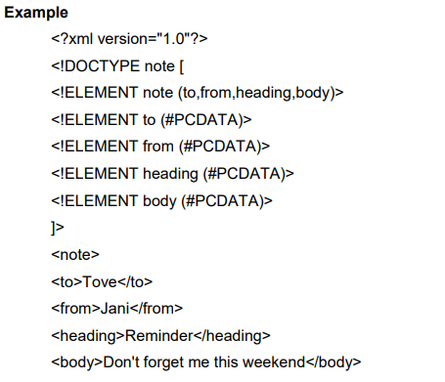


Slide 32
Explanation
The DTD above is interpreted like this:
!DOCTYPE note defines that the root element of this document is note
!ELEMENT note defines that the note element contains four elements: "to, from, heading, body"
!ELEMENT to defines the to element to be of type "#PCDATA"
!ELEMENT from defines the from element to be of type "#PCDATA"
!ELEMENT heading defines the heading element to be of type "#PCDATA"
!ELEMENT body defines the body element to be of type "#PCDATA"

Slide 33

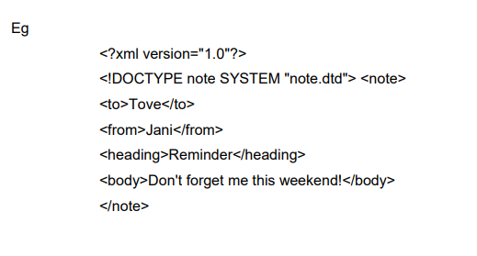
External DTD Declaration
The DTD is declared in an external file
It should be wrapped in a DOCTYPE definition
Syntax:

Slide 34
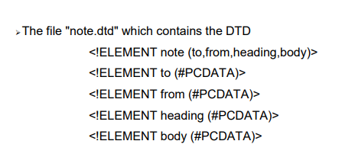
With a DTD, each of your XML files can carry a description of its own format.
With a DTD, independent groups of people can agree to use a standard DTD for interchanging data.
Your application can use a standard DTD to verify that the data you receive from the outside world is valid.
You can also use a DTD to verify your own data.

Slide 35
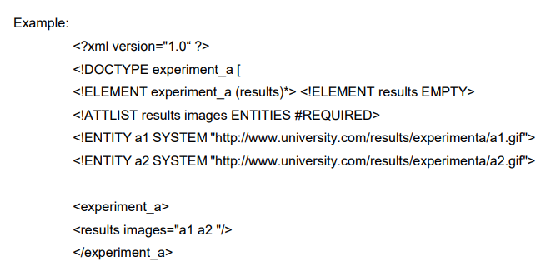
Defining DTD entities - Defining Parameter entities ENTITY
ENTITYs are used to reference data that act as an abbreviation or can be found at an external location.

Slide 36

Working with attributes - Defining attributes - Defining multiple attributes
Using predefined attributes
Attributes are additional information associated with an element type
They are intended for interpretation by an application.
The ATTLIST declarations identify which element types may have attributes, what type of attributes they may be, and what the default value of the attributes are.
Syntax

Slide 37
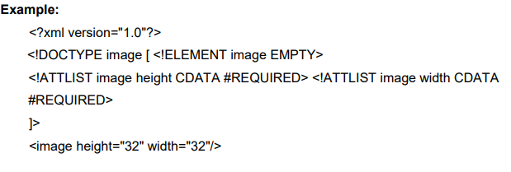

Slide 38
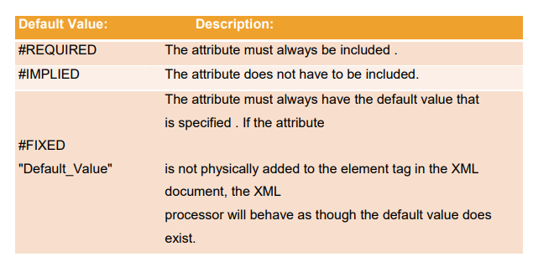
Default values
The "default_value" signifies whether an attribute is required or not, and if not, what default value should be displayed.
The possible default values are listed in below.

Slide 39
Parsed Character Data (PCDATA)
Is a data definition that originated in Standard Generalized Markup Language (SGML), and is used also in Extensible Markup Language (XML) Document Type Definition (DTD) to designate mixed content XML elements.
<sender>Anton Smith</sender>
The string "Anton Smith" would be considered as parsed character data.

Slide 40
CDATA sections in XML
In an XML document or external entity, a CDATA section is a piece of element content that is marked up to be interpreted literally, as textual data, not as marked up content.

Slide 41
Attribute types
There are three main attribute types.
1.A string type
2.A tokenized types
3.A enumerated types
1.A string type:-
CDATA :-
CDATA stands for character data, that is, text that does not form markup.
Example:
<?xml version=“1.0”?>
<!DOCTYPE image [
<!ELEMENT image EMPTY>
<!ATTLIST image height CDATA #REQUIRED>

Slide 42
<!ATTLIST image width CDATA #REQUIRED>]>
<image height=“32” width=“32”/>
2. Tokenized Attribute Type ID :-
ID is a unique identifier of the attribute. IDs of a particular value should not appear more than once in an XML document . An element type may only have one ID attribute . An ID attribute can only have an #IMPLIED or #REQUIRED default value . The first character of an ID value must be a letter, '_', or ':' .
Example
<?xml version=“1.0”?>
<!ELEMENT student_name (#PCDATA)>
<!attlist student_name sudent_no ID #REQUIRED>
]>
<stdent_name student_no=“a9216735”>John Smith</student_name>

Slide 43
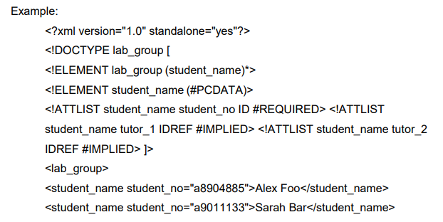

IDREF
IDREF is used to establish connections between elements. The IDREF value of the attribute must refer to an ID value declared elsewhere in the document . The first character of an ID value must be a letter, '_', or ':' .

Slide 44
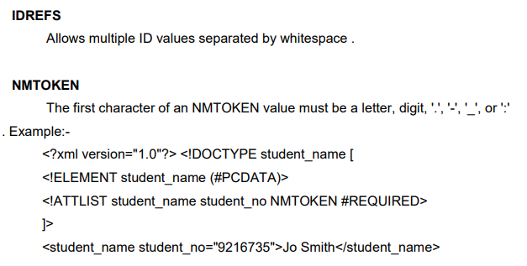
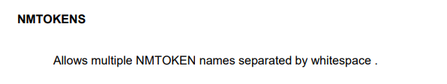

Slide 45

XSL(EXTENSIBLE STYLESHEET LANGUAGE)
XSL is a stylesheet technology which address two important aspects 1.Transform the document from one type to another (XSLT) 2.Styling the document according to the formatting rules XSLT stands for XSL Transformation XSLT is the most important part of XSL Transform the document from one type to another
Syntax:- (root element)
XSL consists of three parts:
XSLT - a language for transforming XML documents
XPath - a language for navigating in XML documents
XSL-FO - a language for formatting XML documents

Slide 46
What is XSLT?
XSLT stands for XSL Transformations
XSLT is the most important part of XSL
XSLT transforms an XML document into another XML document
XSLT uses XPath to navigate in XML documents
XSLT is a W3C Recommendation
XSLT Uses XPath
XSLT uses XPath to find information in an XML document. XPath is used to navigate through elements and attributes in XML documents.

Slide 47

XSLT - Transformation
The root element that declares the document to be an XSL style sheet is or . Note: and are completely synonymous and either can be used!
The correct way to declare an XSL style sheet according to the W3C XSLT Recommendation is:
(or)
To get access to the XSLT elements, attributes and features we must declare the XSLT namespace at the top of the document.
An XSL style sheet consists of one or more set of rules that are called templates.
A template contains rules to apply when a specified node is matched.

Slide 48
The <xsl:template> element is used to build template
The match attribute is used to associate a template with an xml element Match attribute can also be used to define a template for entire xml document
Value of match attribute is an xpath expression ie. match=“/” defines the whole document
<?xml version="1.0"?>
<?xml-stylesheet type="text/xsl" href="books.xsl"?>
<BOOKS>
<BOOK>
<TITLE>java</TITLE>
<AUTHOR>pattrick</AUTHOR>
<PUBLISHER>tata mcgraw hill</PUBLISHER>
<PRICE>530</PRICE>
</BOOK>

Slide 49
<BOOK>
<TITLE>asp</TITLE>
<AUTHOR>micheal</AUTHOR>
<PUBLISHER>tech media</PUBLISHER>
<PRICE>450</PRICE>
</BOOK>
<BOOK>
<TITLE>Lost Symbol</TITLE>
<AUTHOR>Dan Brown</AUTHOR>
<PUBLISHER>Book Worms</PUBLISHER>
<PRICE>380</PRICE>
</BOOK>
<BOOK>
<TITLE>XML Complete Reference</TITLE>
<AUTHOR>Heather Williamson</AUTHOR>
<PUBLISHER>tata mcgraw hill</PUBLISHER>
<PRICE>560</PRICE>
</BOOK>
<BOOK>
<TITLE>The Complete Reference HTML</TITLE>
<AUTHOR>Thomas A. Powell</AUTHOR>

Slide 50
<PUBLISHER>Tata McGraw Hill</PUBLISHER>
<PRICE>450</PRICE>
</BOOK>
<BOOK>
<TITLE>Java Script Complete Reference</TITLE>
<AUTHOR>Thomas A. Powell</AUTHOR>
<PUBLISHER>Tata McGraw Hills</PUBLISHER>
<PRICE>390</PRICE>
</BOOK>
<BOOK>
<TITLE>ASP . Net 4 unleashed</TITLE>
<AUTHOR>Stephen Walther</AUTHOR>
<PUBLISHER>Pearson Education</PUBLISHER>
<PRICE>1530</PRICE>
</BOOK>
<BOOK>
<TITLE>Internet and world wide web</TITLE>

Slide 51
<AUTHOR>Deitel</AUTHOR>
<PUBLISHER>Prentice Hall</PUBLISHER>
<PRICE>1000</PRICE>
</BOOK>
<BOOK>
<TITLE>Computer Graphics</TITLE>
<AUTHOR>Donald Hearn</AUTHOR>
<PUBLISHER>Tata McGraw Hill</PUBLISHER>
<PRICE>450</PRICE>
</BOOK>
<BOOK>
<TITLE>Multimedia</TITLE>
<AUTHOR>Tay Vaughan</AUTHOR>
<PUBLISHER>Tata McGraw Hills</PUBLISHER>
<PRICE>300</PRICE>
</BOOK>
</BOOKS>

Slide 52
<?xml version="1.0"?>
<xsl:stylesheet xmlns:xsl="http://www.w3.org/1999/XSL/Transform" version="1.0">
<xsl:template match="/">
<HTML>
<head>
<style>
table,th,td
{
BORDER: 1px solid black;
}
</style>
</head>
<BODY>
<TABLE BGCOLOR="orange" cellpadding="20" cellspacing="15" align="center">
<CAPTION><b>BOOKS DETAILS</b></CAPTION>
<TR>
<TH>TITLE</TH>
<TH>AUTHOR</TH>
<TH>PUBLISHER</TH>
<TH>PRICE</TH>
</TR>

Slide 53
<xsl:for-each select="BOOKS/BOOK">
<TR>
<TD><xsl:value-of select ="TITLE"/></TD>
<TD><xsl:value-of select ="AUTHOR"/></TD>
<TD><xsl:value-of select ="PUBLISHER"/></TD>
<TD><xsl:value-of select ="PRICE"/></TD>
</TR>
</xsl:for-each>
</TABLE>
</BODY>
</HTML>
</xsl:template>
</xsl:stylesheet>

Slide 54
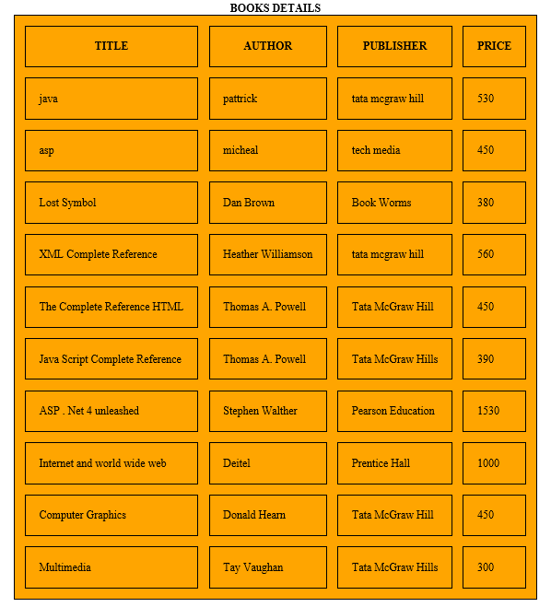
OUTPUT

Slide 55
A Style Sheet to Transform address.xml
<?xml version="1.0" encoding="ISO-8859-1"?>
<xsl:stylesheet version="1.0" xmlns:xsl="http://www.w3.org/1999/XSL/Transform">
<xsl:template match=“/">
<html><head><title>Address Book</title></head>
<body>
<xsl:value-of select="name"/>
<br/><xsl:value-of select="email"/>
<br/><xsl:value-of select="phone"/>
<br/><xsl:value-of select="birthday"/>
</body>
</html>
</xsl:template>
</xsl:stylesheet>

Slide 56
The Result of the Transformation
Alice Lee
alee@aol.com
123-45-6789
1983-7-15

Slide 57
Schemas
Schemas are themselves XML documents.
An XML Schema describes the structure of an XML document.
XML Schema is an XML-based alternative to DTD.
The XML Schema language is also referred to as XML Schema Definition (XSD).
What is an XML Schema?
The purpose of an XML Schema is to define the legal building blocks
An XML Schema:
defines elements that can appear in a document
defines attributes that can appear in a document
defines which elements are child elements
defines the order of child elements

Slide 58
defines the number of child elements
defines whether an element is empty or can include text
defines data types for elements and attributes
defines default and fixed values for elements and attributes of an XML document, just like a DTD.
Advantages
XML Schemas are extensible to future additions
XML Schemas are richer and more powerful than DTDs
XML Schemas are written in XML
XML Schemas support data types
XML Schemas support namespaces
Well-Formed XML schema
A well-formed XML document is a document that conforms to the XML syntax rules, like:
it must begin with the XML declaration
it must have one unique root element

Slide 59
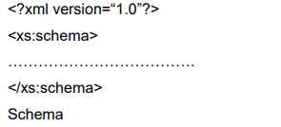
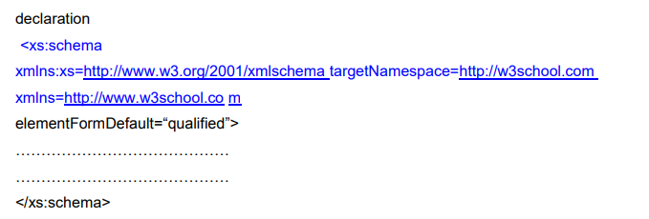
start-tags must have matching end-tags elements are case sensitive
all elements must be closed
all elements must be properly nested
all attribute values must be quoted
entities must be used for special characters
Schema element is the root element of every xml schema

Slide 60
Description
xmlns:xs=http://www.w3.org/2001/XMLSchema
indicates that the elements and data types used in the schema come from the "http://www.w3.org/2001/XMLSchema" namespace should be prefixed with xs:
Target Namespace=http://www.w3schools.com
indicates that the elements defined by this schema (note, to, from, heading, body.) come from the "http://www.w3schools.com" namespace.
xmlns=http://www.w3schools.com
indicates that the default namespace is "http://www.w3schools.com".
elementFormDefault="qualified"
indicates that any elements used by the XML instance document which were declared in this schema must be namespace qualified.

Slide 61

XML SIMPLE ELEMENT
XML Schemas define the elements of your XML files.
What is a Simple Element?
A simple element is an XML element that contains only text. It cannot contain any other elements or attributes.
However, the "only text" restriction is quite misleading.
The text can be of many different types.
It can be one of the types included in the XML Schema definition (boolean, string, date, etc.), or it can be a custom type that you can define yourself.
syntax :
Description
xxx- the name of the element
yyy- the data type of the element.

Slide 62
Schema for First address Example
<?xml version="1.0" encoding="ISO-8859-1" ?>
<xs:schema xmlns:xs="http://www.w3.org/2001/XMLSchema">
<xs:element name="address">
<xs:complexType>
<xs:sequence>
<xs:element name="name" type="xs:string"/>
<xs:element name="email" type="xs:string"/>
<xs:element name="phone" type="xs:string"/>
<xs:element name="birthday" type="xs:date"/>
</xs:sequence>
</xs:complexType>
</xs:element>
</xs:schema>

Slide 63
XML Schema has a lot of built-in data types. The most common types are:
xs:string
xs:decimal
xs:integer
xs:boolean
xs:date
xs:time
Example:-
<lastname>Refsnes</lastname>
<age>36</age>
<dob>1970-03-27</dob>
<per>97.5</per>

Slide 64
Default and Fixed Values for Simple Elements
<xs:element name="color" type="xs:string" default="red"/>
A default value is automatically assigned to the element when no other value is specified. In the following example the default value is "red"
<xs:element name="color" type="xs:string" fixed="red"/>
A fixed value is also automatically assigned to the element, and you cannot specify another value. In the following example the fixed value is "red“.
Example:-
<?xml version=“1.0”?>
<note xmlns="http://www.w3schools.com" xmlns:xsi="http://www.w3.org/2001/XMLSchema- instance"xsi:schemaLocation="http://www.w3schools.com note.xsd">
<to>Tove</to>
<from>Jani<</from>
<body>Don’t forget me this weekend!</body>
</note>

Slide 65
note.xsd
<?xml version="1.0"?>
<xs:schema xmlns:xs="http://www.w3.org/2001/XMLSchema">
<xs:element name="note">
<xs:complexType>
<xs:sequence>
<xs:element name="to" type="xs:string"/>
<xs:element name="from" type="xs:string"/>
<xs:element name="heading" type="xs:string"/>
<xs:element name="body" type="xs:string"/>
</xs:sequence>
</xs:complexType>
</xs:element>
</xs:schema>

Slide 66
XSD ATTRIBUTES
All attributes are declared as simple types.
What is an Attribute?
Simple elements cannot have attributes. If an element has attributes, it is considered to be of a complex type.
But the attribute itself is always declared as a simple type.
syntax :
<xs:attribute name="xxx" type="yyy"/>
Description:-
xxx- the name of the attribute
yyy- specifies the data type of the attribute.

Slide 67
And here are the corresponding simple element definitions:
<xs:element name="lastname" type="xs:string"/> <xs:element name="age" type="xs:integer"/>
<xs:element name="dob" type="xs:date"/>
<xs:element name="per" type="xs:decimal"/>
Example:-
Here is an XML element with an attribute:
<lastname lang="EN">Smith</lastname>
And here is the corresponding attribute definition: <xs:attribute name="lang" type="xs:string"/>
Default and Fixed Values for Attributes <xs:attribute name="lang" type="xs:string" default="EN"/>
A default value is automatically assigned to the attribute when no other value is specified. In the following example the default value is "EN":

Slide 68
<xs:attribute name="lang" type="xs:string" fixed="EN"/>
A fixed value is also automatically assigned to the attribute, and you cannot specify another value. In the following example the fixed value is "EN":
XSD Complex Elements
A complex element contains other elements and/or attributes.
What is a Complex Element?
A complex element is an XML element that contains other elements and/or attributes. There are four kinds of complex elements:
empty elements
elements that contain only other elements
elements that contain only text
elements that contain both other elements and text
Note: Each of these elements may contain attributes as well!
Example:
A complex XML element, "product", which is empty:
<product pid="1345"/>

Slide 69
A complex XML element, "employee", which contains only other elements: <employee>
<firstname>John</firstname>
<lastname>Smith</lastname>
</employee>
A complex XML element, "food", which contains only text:
<food type="dessert">Ice cream</food>
A complex XML element, "description", which contains both elements and text:
<description>
It happened on <date lang="norwegian">03.03.99</date> .... </description>

Slide 70
Example Program:
Simple XML Element
<employee>
<firstname>John</firstname>
<lastname>
</employee>
XSD format
<xs:element name=“employee”>
<xs:complexType>
<xs:sequence>
<xs:element name=“firstname” type=“xs:string”/>
<xs:element name=“lastname” type=“xs:string”/>
</xs:sequence>
</xs:complexType>
</xs:element>

Slide 71
XML QUERY (XQUERY)
Xquery is for XML like SQL for database
Xquery is used to finding & Extracting elements and attributes from XML document
XQuery is the language for querying XML data
XQuery for XML is like SQL for databases
XQuery is built on XPath expressions
XQuery is supported by all major databases
XQuery is a W3C Recommendation
XQuery Basic Syntax Rules
XQuery is case-sensitive
XQuery elements, attributes, and variables must be valid XML names
An XQuery string value can be in single or double quotes
An XQuery variable is defined with a $ followed by a name

Slide 72
DOM parser.html
<html>
<body>
<h1>Simple XML Parser using String</h1>
<div>
<b>To:</b> <span id="to"></span><br/>
<b>From:</b> <span id="from"></span><br/>
<b>Heading:</b> <span id="head"></span><br/>
<b>Message:</b> <span id="message"></span>
</div>
<script type="text/javascript">
txt="<note>";
txt=txt+"<to>Balu</to>";
txt=txt+"<from>Raju</from>";
txt=txt+"<heading>Reminder</heading>";
txt=txt+"<body>Hi, Good morning III year IT...</body>";
txt=txt+"</note>";
if (window.DOMParser)

Slide 73
{
parser=new DOMParser();
xmlDoc=parser.parseFromString(txt,"text/xml");
}
else
{
xmlDoc=new ActiveXObject("Microsoft.XMLDOM");
xmlDoc.async=false;
xmlDoc.loadXML(txt);
}
document.getElementById("to").innerHTML=xmlDoc.getElementsByTagName("to")[0].childNodes[0].nodeValue;
document.getElementById("from").innerHTML=xmlDoc.getElementsByTagName("from")[0].childNodes[0].nodeValue;
document.getElementById("head").innerHTML=xmlDoc.getElementsByTagName("heading")[0].childNodes[0].nodeValue;
document.getElementById("message").innerHTML=xmlDoc.getElementsByTagName("body")[0].childNodes[0].nodeValue;
</script>
</body>
</html>

Slide 74
